Slide 1
Employee Burnout Prediction

Slide 2

Student Details
Name : Shaik Mabasha
Reg No: AP22110011144
College name: SRM university AP
Company name: EDUnet
Domain: ai
Internship start date: 06-06-2024
Internship end date: 31-07-2024

Slide 3
PROJECT TITLE/Problem Statement
Problem statement: To develop a predictive model for employee burnout using machine learning techniques. By analyzing various workplace factors and employee data, we seek to identify key indicators of burnout and provide actionable insights to help organizations implement proactive measures. Our goal is to enhance employee well-being, improve job satisfaction, and increase overall productivity by preventing burnout before it manifests."

Slide 4
AGENDA
Agenda: Development of Employee Burnout Prediction Model
Data Collection and Preprocessing
Project Overview
End users
Solution and value proposition
Customization for Organization
Modelling
Results

Slide 5
PROJECT OVERVIEW
This project focuses on developing a predictive model for employee burnout using machine learning techniques. By analyzing various workplace factors such as workload, job satisfaction, and support systems, the model aims to identify key indicators of burnout and predict burnout levels. This enables organizations to proactively address burnout risks, ensuring a healthier and more productive work environment.

Slide 6
Data collection
Source: the dataset was sourced from Kaggle, a platform known for hosting various datasets for data science and machine learning projects. 1.employee ID: unique identifier for each employee. 2.Date of joining: the date when the employee joined the company. 3.Gender: the gender of the employee (male/ female). 4.Company type: the type of the company where the employee is working. (Service/product) 5.WFH setup availability: indicates whether the employee has the setup to work from home (yes/no). 6.Designation: the level of designation of the employee, ranging from 0.0 to 5.0. 7.Resource allocation: number of working hours in the range of [0.0, 10.0]. 8.Mental fatigue score: A score indicating the level of mental fatigue experienced by the employee in the range of [0.0, 10.0]. 9.Burn rate: the rate at which the employee is experiencing burnout, which is the target variable. Range is [0.0, 1.0].

Slide 7
Data PReprocessing
1.Handling Missing Values: Impute or remove missing data.
2. Normalization and Scaling: Normalize or scale features to ensure uniformity.
3. Categorical Encoding: Convert categorical variables into numerical representations using techniques like one-hot encoding.
4. Feature Engineering: Create new features based on domain knowledge (e.g., average hours worked per week over the last month).

Slide 8
WHO ARE THE END USERS of this project?
The end users of the Employee Burnout Prediction project are primarily Human Resources (HR) professionals and organizational leaders who aim to improve employee well-being and productivity. Additionally, managers can utilize the insights to support their team members effectively. Employees themselves benefit indirectly through improved workplace policies and support systems. Overall, the project serves the entire organization by fostering a healthier work environment.

Slide 9
YOUR SOLUTION AND ITS VALUE PROPOSITION
By identifying burnout causes and risk factors, we can implement proactive strategies that enhance employee well-being and engagement. The value proposition of our solution lies in reducing burnout-related costs, enhancing employee satisfaction and retention, and contributing to overall organizational success. Our solution combines data analysis, predictive modeling, and targeted interventions to address employee burnout and promote a healthier work environment.

Slide 10
How did you customize the project and make it your own
The project was customized to fit the organization's particular requirements and environment. The techniques for gathering and analyzing data have been modified to the particular group of workers, guaranteeing the applicability and significance of the discoveries and actions. The project was customized to meet the organization's unique issues and advance intended results by taking into account the organization's values, culture, and goals. This modification allowed for the creation of a project that is specifically tailored to the organization's needs in order to effectively manage employee burnout and promote a positive work environment.

Slide 11
MODELLING
Model Selection:
Chosen Model: Supervised linear regression was selected due to its simplicity and interpretability.
Selection Criteria: Models were evaluated based on performance metrics such as R-squared and Mean Squared Error (MSE) and Mean Absolute Error.
Feature Engineering:
Categorical to Numerical: Converted categorical variables like gender and company name to numerical values using Label Encoder.
Important Features: Identified mental fatigue score as the most significant predictor of burn rate.

Slide 12
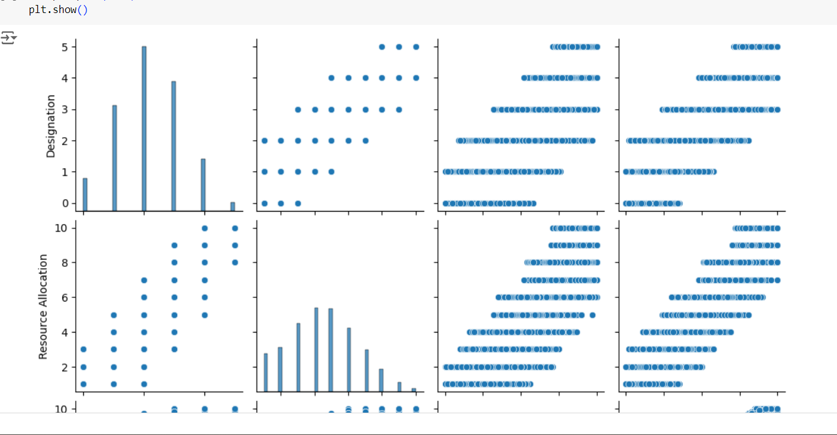
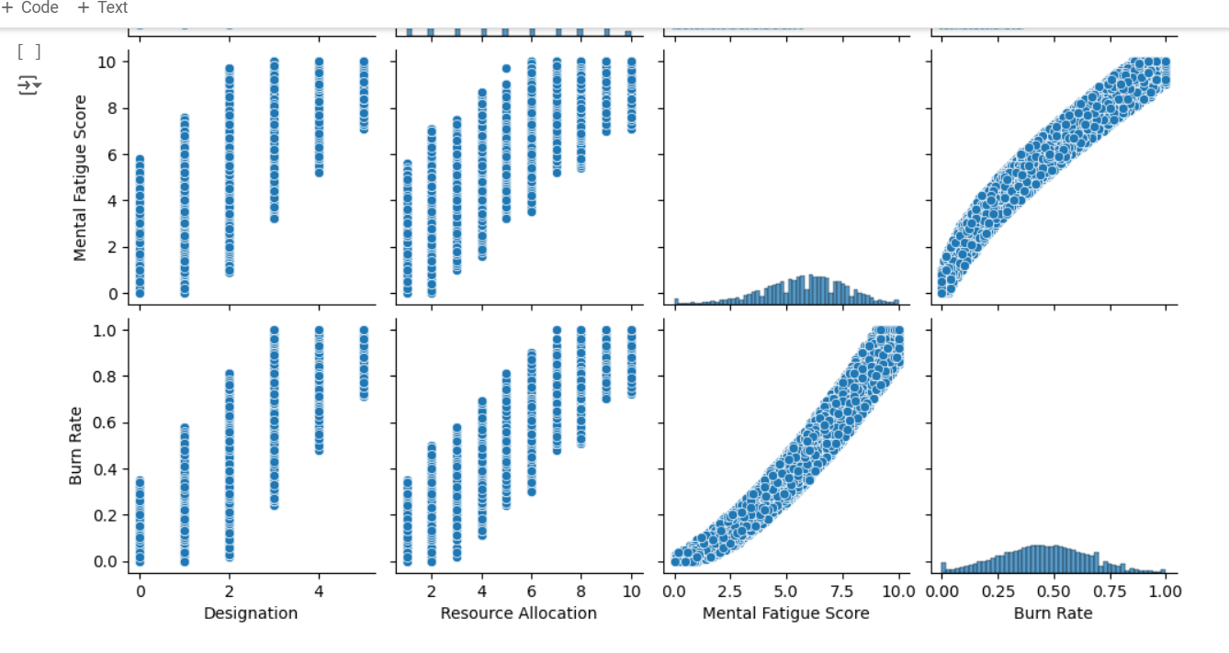
Results
Mental fatigue score is highly correlated with burn rate.
Employees with higher resource allocation tend to have a lower burn rate.

Slide 13
links
GitHub link:
https://github.com/mabasha17/Employee_Burnout_Prediction
LinkedIn profile:
https://www.linkedin.com/in/mabasha/

Slide 14
Thank you

